Slide 1
When Medical and Pharmacy Students Learn From Each Other:
“It is a great learning experience to be able to work with the medical students. Honestly this type of inter-professional training will change the next generation of healthcare professionals. We will be more collaborative patient care providers and that is what the healthcare system needs.” Pharmacy Student
Understanding Interprofessional Education
Amanda Engle, PharmD, BCPS
Assistant Professor
Albany College of Pharmacy and Health Sciences

Slide 2
Objectives
Define interprofessional education according to the World Health Organization and the Interprofessional Education Collaborative Core Competencies
Compare and contrast medical school and pharmacy school accreditation and core entrustable professional activity requirements for interprofessional education
Identify tools to help launch interprofessional education opportunities at your practice site
Describe a medical and pharmacy student interprofessional education model and its impact on student learning and patient care

Slide 3
Defining Interprofessional Education
“Interprofessional education occurs when students from two or more professions learn about, from, and with each other to enable effective collaboration and improve health outcomes. Once students understand how to work interprofessionally, they are ready to enter the workplace as a member of the collaborative practice team. This is a key step in moving health systems from fragmentation to a position of strength.”
“Interprofessional education occurs when students from two or more professions learn about, from, and with each other to enable effective collaboration and improve health outcomes.
Once students understand how to work interprofessionally, they are ready to enter the workplace as a member of the collaborative practice team.
This is a key step in moving health systems from fragmentation to a position of strength.”
World Health Organization (WHO). (2010). Framework for action on interprofessional education & collaborative practice. Geneva: World Health Organization.

Slide 4
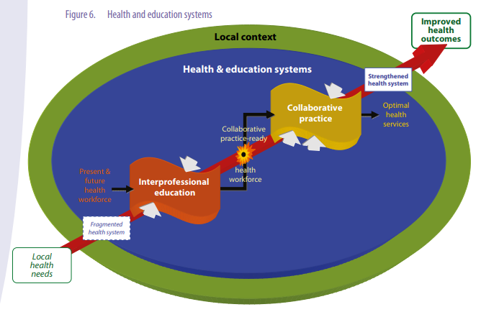
World Health Organization (WHO). (2010). Framework for action on interprofessional education & collaborative practice. Geneva: World Health Organization.

Slide 5
World Health Organization (WHO). (2010). Framework for action on interprofessional education & collaborative practice. Geneva: World Health Organization.

Slide 6
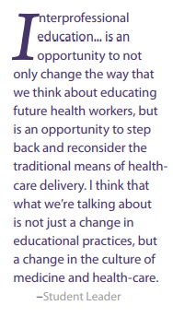
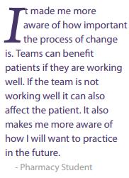
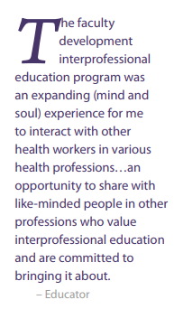
World Health Organization (WHO). (2010). Framework for action on interprofessional education & collaborative practice. Geneva: World Health Organization.

Slide 7
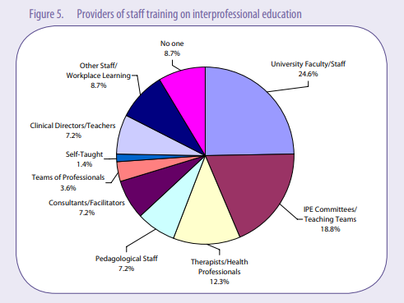
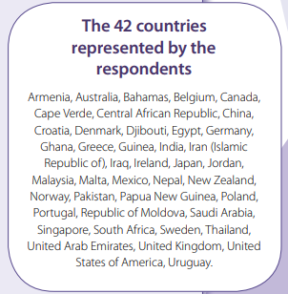
World Health Organization (WHO). (2010). Framework for action on interprofessional education & collaborative practice. Geneva: World Health Organization.
Notes:
To capture current interprofessional activities at a global level, the WHO Study Group on Interprofessional Education and Collaborative Practice conducted an international environmental scan between February and May 2008. The aim of this scan was to: * Determine the current status of interprofessional education globally * Identify best practices * Illuminate examples of successes, barriers and enabling factors in interprofessional education. A total of 396 respondents, representing 42 countries from each of the six WHO regions, provided insight about their respective interprofessional education programmes. These individuals represent various fields including practice (14.1 per cent), administration (10.6 per cent), education (50.4 per cent) and research (11.6 per cent). Results indicate that interprofessional education takes place in many different countries and healthcare settings across a range of income categories.* It involves students from a broad range of disciplines including allied health, medicine, midwifery, nursing and social work. For most respondents, interprofessional education was compulsory.

Slide 8
Academy of Nutrition and Dietetics (ACEND)
American Association of Colleges of Nursing (AACN)
American Association of Colleges of Osteopathic Medicine (AACOM)
American Association of Colleges of Pharmacy (AACP)
American Association of Colleges of Podiatric Medicine (AACPM)
American Association for Respiratory Care (AARC)
American Council of Academic Physical Therapy (ACAPT)
American Dental Education Association (ADEA)
American Occupational Therapy Association (AOTA)
American Psychological Association (APA)
American Speech-Language Hearing Association (ASHA)
Association of Academic Health Sciences Libraries (AAHSL)
Association of American Medical Colleges (AAMC)
Association of American Veterinary Medical Colleges (AAVMC)
Association of Chiropractic Colleges (ACC)
Association of Schools and Colleges of Optometry (ASCO)
Association of Schools and Programs of Public Health (ASPPH)
Association of Schools of Allied Health Professions (ASAHP)
Council on Social Work Education (CSWE)
National League for Nursing (NLN)
Physician Assistant Education Association (PAEA)
Interprofessional Education Collaborative. (2016). Core competencies for interprofessional collaborative practice: 2016 update. Washington, DC: Interprofessional Education Collaborative.
Notes:
In 2009, six national associations of schools of health professions formed a collaborative to promote and encourage constituent efforts that would advance substantive interprofessional learning experiences. The goal was, and remains, to help prepare future health professionals for enhanced team-based care of patients and improved population health outcomes. The collaborative, representing dentistry, nursing, medicine, osteopathic medicine, pharmacy, and public health, convened an expert panel of representatives from each of the six IPEC sponsor professions to create core competencies for interprofessional collaborative practice, to guide curriculum development across health professions schools. The competencies and implementation recommendations subsequently published in the 2011 Core Competencies for Interprofessional Collaborative Practice have been broadly disseminated.

Slide 9
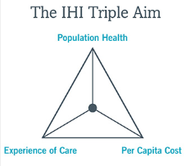
“…interprofessional collaborative practice is key to the safe, high-quality, accessible, patient-centered care desired by all.”
http://www.ihi.org/Engage/Initiatives/TripleAim/Pages/default.aspx
Interprofessional Education Collaborative. (2016). Core competencies for interprofessional collaborative practice: 2016 update. Washington, DC: Interprofessional Education Collaborative.
Notes:
The US health care system is the most costly in the world, accounting for 17% of the gross domestic product with estimates that percentage will grow to nearly 20% by 2020. [Source: National Healthcare Expenditure Projections, 2010-2020. Centers for Medicare and Medicaid Services, Office of the Actuary.] At the same time, countries with health systems that out-perform the US are also under pressure to derive greater value for the resources devoted to their health care systems. Aging populations and increased longevity, coupled with chronic health problems, have become a global challenge, putting new demands on medical and social services.
In most health care settings today, no one is accountable for all three dimensions of the IHI Triple Aim. For the health of our communities, for the health of our school systems, and for the health of all our patients, we need to address all three of the Triple Aim dimensions at the same time.
Organizations and communities that attain the Triple Aim will have healthier populations, in part because of new designs that better identify problems and solutions further upstream and outside of acute health care. Patients can expect less complex and much more coordinated care and the burden of illness will decrease. Importantly, stabilizing or reducing the per capita cost of care for populations will give businesses the opportunity to be more competitive, lessen the pressure on publicly funded health care budgets, and provide communities with more flexibility to invest in activities, such as schools and the lived environment, that increase the vitality and economic wellbeing of their inhabitants.

Slide 10
Work with individuals of other professions to
maintain a climate of mutual respect and shared values
IPE
Values/Ethics
Teams/
Teamwork
Communication
Roles/
Responsibilities
Use the knowledge of ones own role and those of other professions to appropriately assess and address the health needs of patients and to promote and advance the health of populations
Apply relationship-building values and principles of team dynamics to perform effectively in different team roles to plan, deliver, and evaluate patient/population-centered care and population health programs and policies that are safe, timely, efficient, effective, and equitable
Interprofessional Education Collaborative. (2016). Core competencies for interprofessional collaborative practice: 2016 update. Washington, DC: Interprofessional Education Collaborative.
Communicate with patients, families, communities, and professionals in other fields in a responsive and reasonable manner that supports a team approach to the promotion and maintenance of health and the prevention and treatment of disease

Slide 11
Values/Ethics
Interprofessional Education Collaborative. (2016). Core competencies for interprofessional collaborative practice: 2016 update. Washington, DC: Interprofessional Education Collaborative.

Slide 12
Communication
Interprofessional Education Collaborative. (2016). Core competencies for interprofessional collaborative practice: 2016 update. Washington, DC: Interprofessional Education Collaborative.

Slide 13
Roles/ Responsibilities
Interprofessional Education Collaborative. (2016). Core competencies for interprofessional collaborative practice: 2016 update. Washington, DC: Interprofessional Education Collaborative.

Slide 14
Teams/ Teamwork
Interprofessional Education Collaborative. (2016). Core competencies for interprofessional collaborative practice: 2016 update. Washington, DC: Interprofessional Education Collaborative.

Slide 15
NATIONAL COLLEGE ACCREDITATION STANDARDS
Medical School Liaison Committee on Medical Education (LCME) Standards for Accreditation of Medical Education Programs Leading to the MD Degree | Pharmacy School Accreditation Council for Pharmacy Education (ACPE) Accreditation Standards and Key Elements for the Professional Program in Pharmacy Leading to the Doctor of Pharmacy Degree
7.9 Interprofessional Collaborative Skills The faculty of a medical school ensure that the core curriculum of the medical education program prepares medical students to function collaboratively on health care teams that include health professionals from other disciplines as they provide coordinated services to patients. These curricular experiences include practitioners and/or students from the other health professions. | Standard 11: Interprofessional Education The curriculum prepares all students to provide entry-level, patient-centered care in a variety of practice settings as a contributing member of an interprofessional team. In the aggregate, team exposure includes prescribers as well as other healthcare professionals. The ACPE Board provides further interpretation of its intention of prescribers and student prescribers to be included in both the didactic and experiential components of the curriculum; and that physicians and their students are to be included in the mix of prescribers and their students.

Slide 16
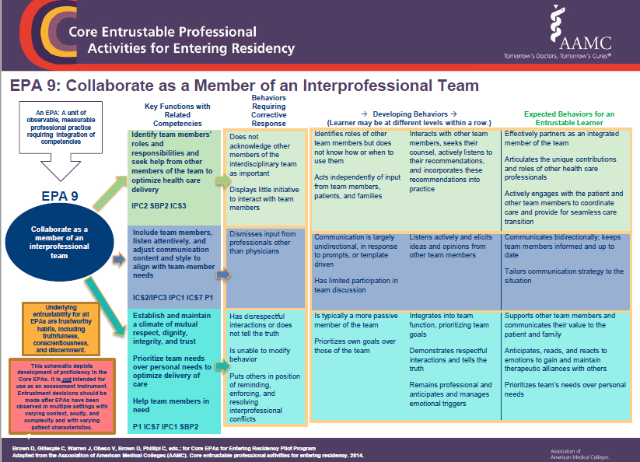
Medical Education IPE EPAs
Obeso V,et al. Core EPAs for Entering Residency Pilot Program. Toolkits for the 13 Core Entrustable Professional Activities for Entering Residency. Washington, DC: Association of American Medical Colleges; 2017.

Slide 17
Pharmacy Education IPE EPAs
American Journal of Pharmaceutical Education 2017; 81 (1) Article S2.

Slide 18
Practical Tools
NEXUS
ACPHS Experiential Interprofessional Faculty Toolbox
ACPHS-AMC Interprofessional Education Steering Committee
IPEC Fall 2019 Institute
MedEd Portal – Interprofessional Education

Slide 19
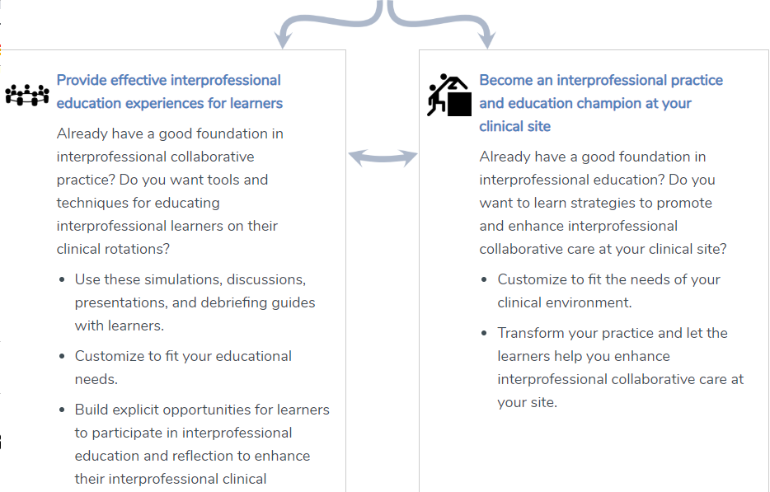
NEXUS
https://nexusipe.org/engaging/learning-system/preceptors-nexus-toolkit

Slide 20
NEXUS
https://nexusipe.org/engaging/learning-system/preceptors-nexus-toolkit

Slide 21
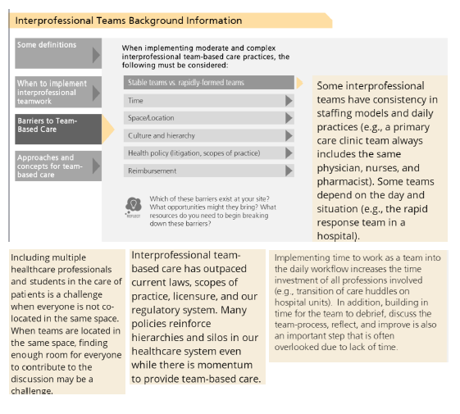
NEXUS
https://nexusipe.org/engaging/learning-system/preceptors-nexus-toolkit

Slide 22
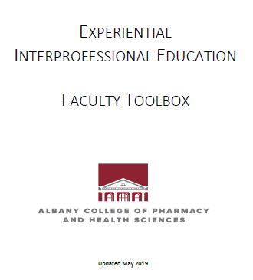
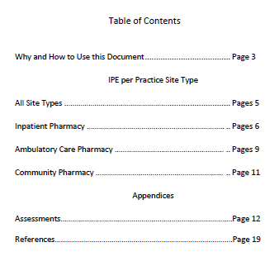
Accessible to Preceptors on CoreELMS

Slide 23
Intended Use
1. Review the section that applies to your practice setting (eg. ambulatory, inpatient, community)
2. Choose one of the IPE learning models within that section that may be most likely to adapt to your practice site. Contact the author(s) to discuss how applying that model may work for you.
3. Reach out to the current editors, Drs. Amanda Engle and Jeffrey Brewer, to add new IPE events at your site.

Slide 24
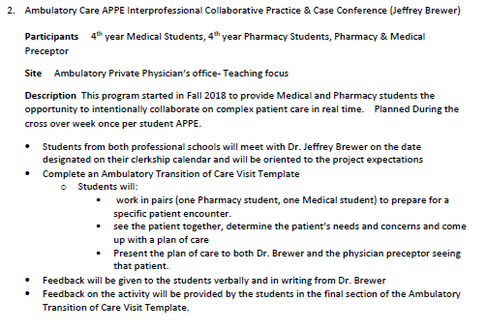

Slide 25
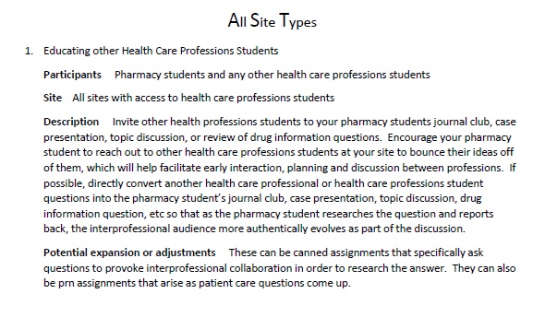

Slide 26
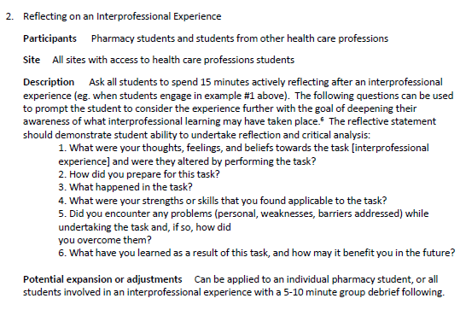

Slide 27
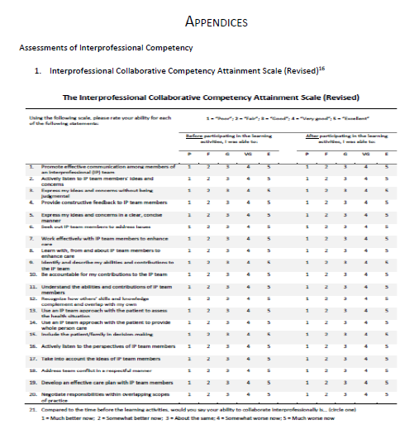
Archibald, D., et al (2014). Validation of the interprofessional collaborative competency attainment survey (ICCAS), Journal of Interprofessional Care, 28:6, 553-558

Slide 28
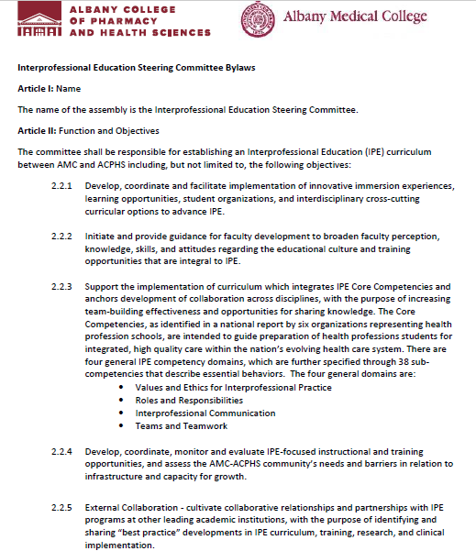
Equal representation of membership from both AMC and ACPHS
Comprised of Student, Faculty, Resident, Administrative members
Charge: Establishing an IPE Curriculum between AMC and ACPHS
Chairs:
Dr. Carol L. Cabral
Assistant Dean of Medical Education, Years 3 & 4
Dr. Amanda Engle

Slide 29
Institute Focus:
To provide health professions faculty and their interprofessional colleagues the opportunity to acquire and utilize advanced knowledge and skills to further enhance their existing institutional interprofessional education and collaborative practice programs.
https://www.ipecollaborative.org/2019-fall-institute.html

Slide 30
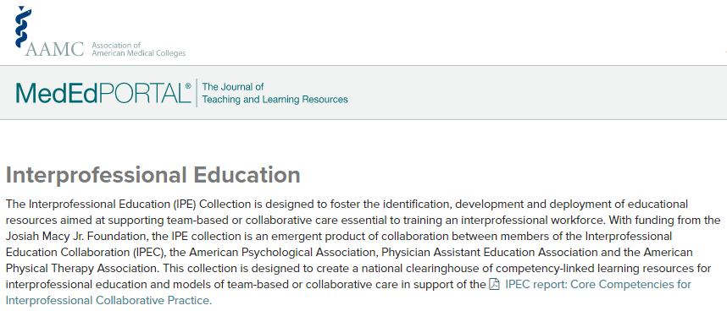
https://www.mededportal.org/collection/interprofessional-education/

Slide 31
Case Studies: ACPHS-AMC Student IPE Models
1) Pharmacy Interprofessional Experience – PIPE
2) Inpatient Internal Medicine IPE Rounding Team
Program Design
Educational and Clinical Impacts

Slide 32
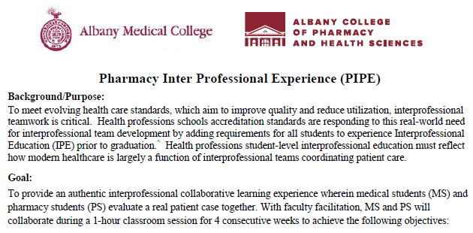

Slide 33
PIPE Objectives
Reconcile the home and inpatient medication list using evidence-based practices
Apply the list of drug related problems (DRPs) to the patient case
Identify and apply evidence-based resources within a therapeutic focus according to the patient selection chart below

Slide 34
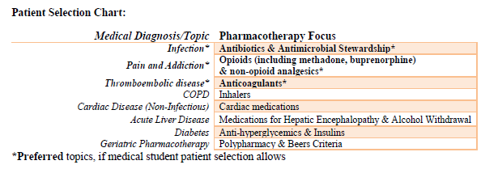
PIPE Design

Slide 35
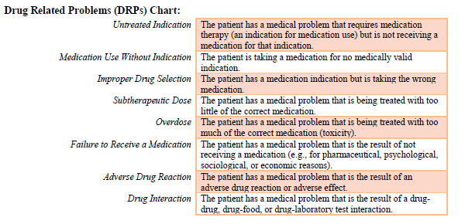
PIPE Design

Slide 36
PIPE Design
Patient Presentation Criteria
Selected patients must be currently admitted, personally seen by the presenting MS, and undergoing acute care management of at least one of the topics outlined in the Patient Selection Chart. Once a topic is presented on, it may not be repeated at a subsequent PIPE.
Patient presentations should include all of the following elements:
CC/HPI
PMH
Allergies
Medications (Home Meds & Inpatient Meds)
Physical Examination: vitals and relevant PE components
Relevant Labs & Imaging
Final Diagnosis (or top 3 if still unknown)

Slide 37
PIPE Design
Week 1
MS presents only a one-liner & MRN on any patient seen that day
This week’s topic is best practices in collecting a home medication history, medication reconciliation, and identification of drug related problems
1:00 - 1:15 pm | Introductions
1:15 - 1:20 pm | Group consensus to determine the 3 topics we will discuss at each subsequent 3 PIPE sessions, using patient selection chart
1:20 - 1:30 pm | MS presents one-liner & MRN of patient seen that morning Group review of home and inpatient medications
1:30 – 1:45 pm | MS and PS divide into evenly distributed small groups to evaluate the home and inpatient medications, and assess for Drug Related Problems including drug interactions (see above for DRP explanation)
1:45 – 2:00 pm | Small groups present findings to entire group, with faculty led discussion of clinical learning

Slide 38
PIPE Design
Weeks 2, 3, 4
All teams must come prepared to each of the subsequent 3 PIPE sessions prepared to fully present one patient that fits the patient selection chart criteria according to the 3 agreed upon topics determined during week 1.
All teams provide a 1 liner to entire group at start of PIPE. Medical and pharmacy faculty will select one of the team’s patients for full presentation, per below patient presentation criteria.
1:00 - 1:10 pm | All teams provide a 1 liner of a patient that fits into selected therapeutic topic for the week. Medical and pharmacy faculty select one of the team’s patients for full presentation.
1:10 - 1:15 pm | One MS team fully presents patient, including Soarian login to display supporting information
1:15 - 1:20 pm | Entire group determines primary diagnostic problem and pharmacotherapeutic problem
1:20 - 1:40 pm | MS and PS divide into evenly distributed small groups to evaluate the primary problems, using PIPE Problem Solving Guide (see below)
1:40 – 2:00 pm | Small groups present findings to entire group, with faculty led discussion of clinical learning

Slide 39
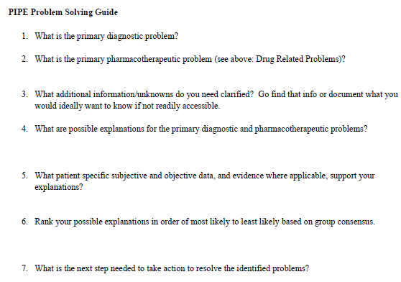

Slide 40
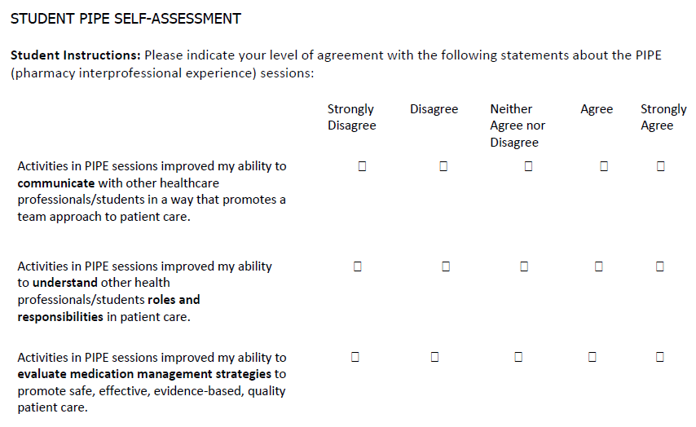

Slide 41
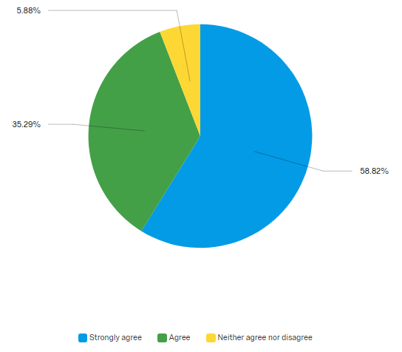
PIPE Outcomes
Activities in PIPE sessions improved my ability to communicate with other healthcare professionals/students in a way that promotes a team approach to patient care.
Notes:
94% agree

Slide 42
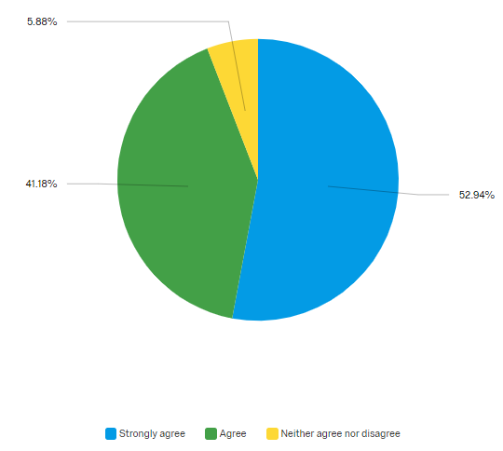
PIPE Outcomes
Activities in PIPE sessions improved my ability to understand other health professionals/students roles and responsibilities in patient care.
Notes:
94% agree

Slide 43
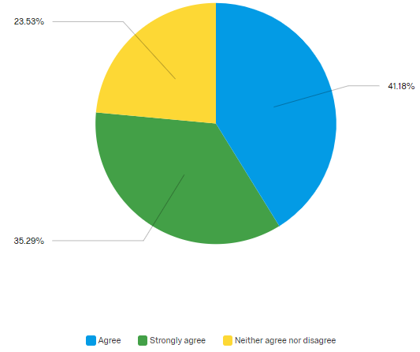
PIPE Outcomes
Activities in PIPE sessions improved my ability to evaluate medication management strategies to promote safe, effective, evidence-based, quality patient care.
Notes:
76% agree

Slide 44
Pharmacy Student PIPE Thoughts
“Part of my role in the PIPE sessions was to help the medical students assess real patient cases for medication related problems. In order to be successful in my role, I had to be able to understand and properly verbalize my thought process to my medical student peers. This required me to take extra time to think about my thought process as a student pharmacist so that I could properly explain it to those who were unfamiliar with it.”

Slide 45
Medical Student PIPE Thoughts
“Extremely helpful when we went through each medication, their indication, and dosing, leading to discussion about interactions and proper usage.”
“Excellent program, made me further realize how intricate and difficult patient medications are.”
“I think the framework of thinking through medication management (undertreated, overtreated, drug interactions, etc) is very helpful.”
“I think it was most helpful to work in teams of mixed medical students and pharmacy students, that way we got to know each other and work together!”
“PIPE was very helpful and led my inpatient team to discovering that a high VTE risk patient was not on appropriate prophylaxis.”

Slide 46
Interprofessional Education Team Rounds

Slide 47
IPE Team Rounds
Collaborating to establish an interprofessional rotation, fourth year medical students of Albany Medical College and fourth year pharmacy students of ACPHS created interprofessional education teams consisting of a pair of medical and pharmacy students on each team.
Student teams pre-rounded on patients without faculty present, interviewing and collecting data to obtain pertinent information necessary to formulate care plans and present findings to the Attending Physician and Pharmacist during rounds.
During rounds, pharmacy student recommendations were discussed with real-time orders being placed by the medical students.
Notes:
Student teams worked together for a 6 week rotation, seeing adult medicine patients at Albany Medical Center.

Slide 48
Notes:
Med History, Med rec

Slide 49
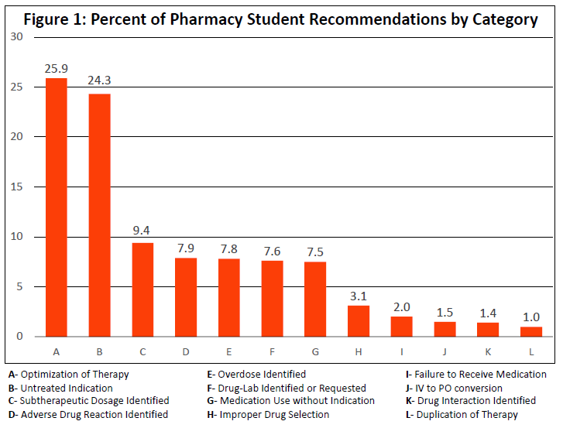
266 patient encounters
690 pharmacotherapy recommendations
85% Acceptance rate
Notes:
36 week period

Slide 50
Archibald, D., et al (2014). Validation of the interprofessional collaborative competency attainment survey (ICCAS), Journal of Interprofessional Care, 28:6, 553-558

Slide 51
ICCAS survey results post interprofessional collaboration revealed a 70% increase [95% confidence interval 11.55-14.81, p < 0.05] in the self-reported attitudes about IPE and the perceived ability to engage in collaborative practice.

Slide 53
Pharmacy Student IPE Rounding Team Thoughts

Slide 54
The interprofessional aspect of this experience had the biggest impact on me. Learning to work together with medical students provided me with insight into the aspects of patient care that medical students provide versus what pharmacy students provide. Understanding how our roles differed allowed me to maximize my contributions on the team and give recommendations that showcased the value of a pharmacy student. Working with the medical students also challenged me to create interprofessional relationships centered on trust and mutual respect.

Slide 55
It was a practice changing experience to work with a 4th year student as they had equal knowledge to me in their field as I did my own. We were able to use our skills to complement each other and solve present patient care problems
To my medical students this was invaluable information that they were extremely grateful for and in addition they learned more therapeutics as we continued to round with them. I was also able to learn so much more about disease states and that I otherwise would have never known.

Slide 56
By fitting into a role alongside medical students, we were able to lean on each other to complement our areas of strength and weakness to better serve patients.
I believe this rotation has a strong focus on communication skills to both peers and medical attendings. While communication is discussed in school, real life interprofessional practice on how to communicate among professions is a great experience.

Slide 57
This rotation made me do a complete revision on what I want to be when I become a pharmacist. This rotation made me want to apply Phase II for residency which I never foresaw before this opportunity to work on a clinical interprofessional team. This opportunity completely changed my perspective on clinical pharmacy and it impacted me for the better.

Slide 58
Working with medical students and a medical attending showed me how to provide enough evidence-based information to guide patient care. Working inter professionally in a time-sensitive environment allowed me to develop a filter for which information to present in order to make recommendations.

Slide 59
I loved having the opportunity to work with not just a medicine team, but medical students. As a pharmacy student, I am always so nervous to talk to doctors and make recommendations because I am intimidated by their knowledge and skill set. Being able to work alongside students who aren’t quite as seasoned makes it a lot easier to understand that we all started at a similar level.
Direct collaboration with 4th year medical students was the most valuable aspect of this rotation. This collaboration helped foster positive relationships which will continue even after the rotation has ended. It also provided the opportunity for me, as a pharmacy student, to show my value-add to the medical students and increase their understanding of the role that pharmacy members play on the healthcare team.

Slide 60
Working alongside medical student colleagues has left me with the most meaningful impression overall. I am now a firm believer that in order to effectively work together as healthcare professionals, we must learn together as effective students. This will definitely effect the way in which I practice pharmacy now having completed this interprofessional experience. Being a member of the internal medicine team as a student and being relied on for recommendations and assessment of medication-related problems has intensified my motivation in the pursuit of a residency. I have an increased appreciation for interprofessional education and collaboration as a means to improve patient outcomes.

Slide 61
Questions?
“It is a great learning experience to be able to work with the medical students. Honestly this type of inter-professional training will change the next generation of healthcare professionals. We will be more collaborative patient care providers and that is what the healthcare system needs.” Pharmacy Student
Amanda Engle, PharmD, BCPS
Assistant Professor
Albany College of Pharmacy & Health Sciences
Amanda.Engle@acphs.edu

