Slide 1
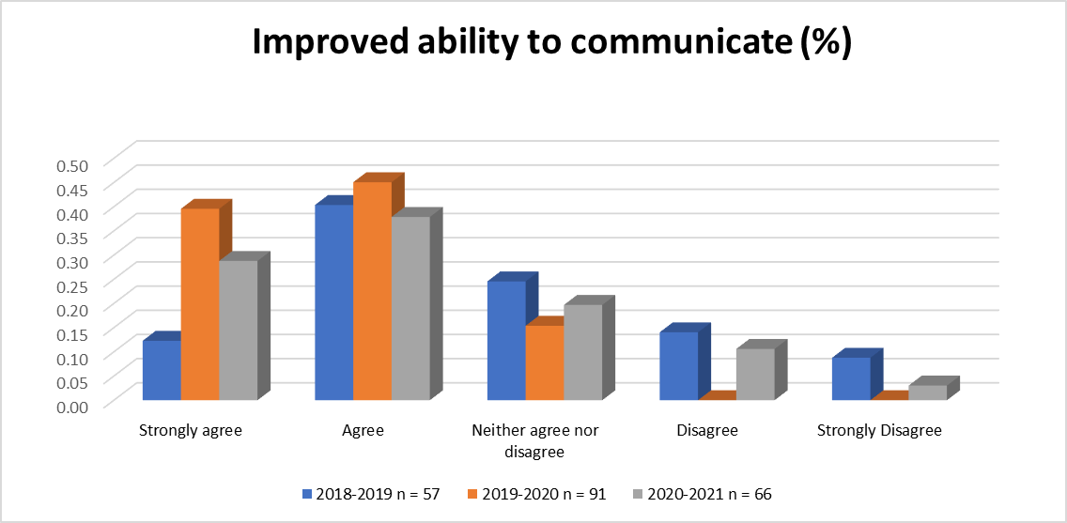
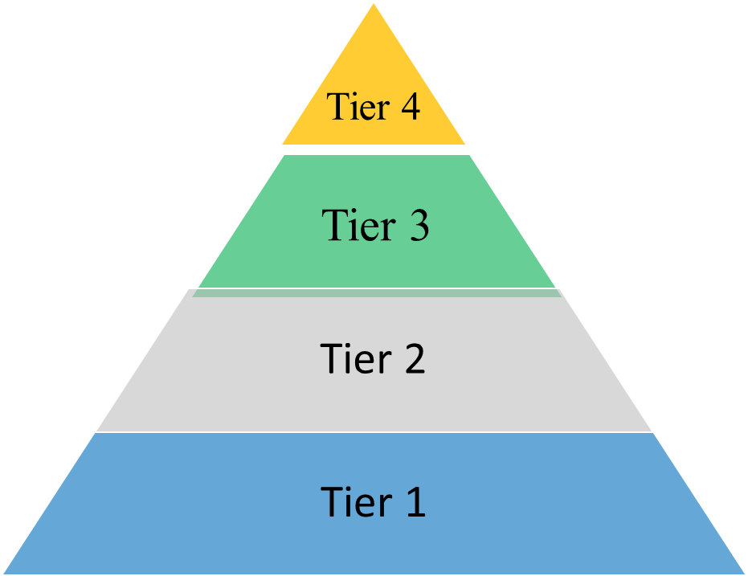
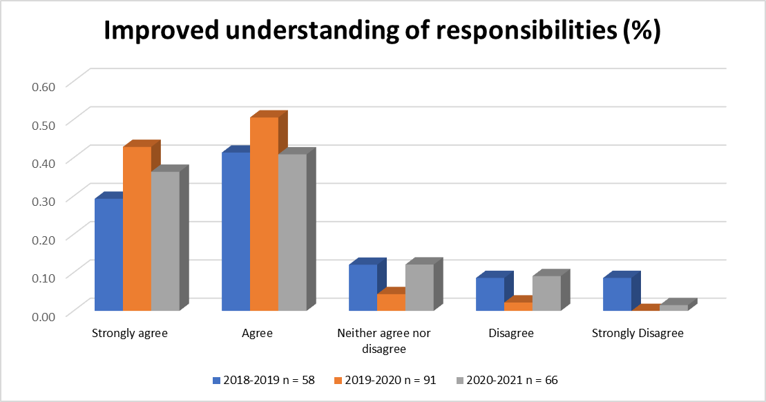
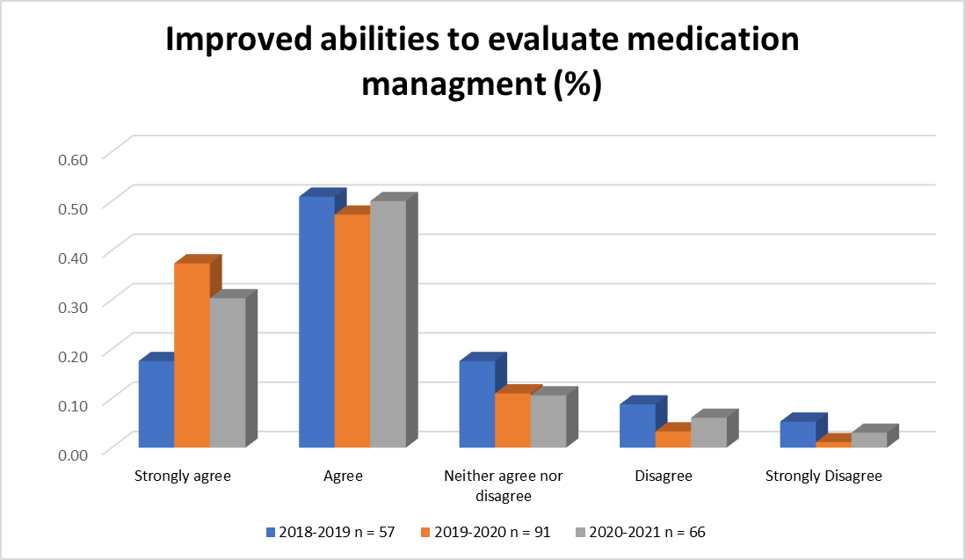
CREATING AN INTERPROFESSIONAL EDUCATIONAL EXPERIENCE WITH MEDICAL AND PHARMACY STUDENTS:
IT DOESN’T HAVE TO BE A “PIPE” DREAM!
AMANDA ENGLE, PHARMD^{1,2}; JACKCY JACOB, MD²; JOSEPH WAYNE, MD²
¹ Albany College of Pharmacy & Health Sciences; ² Albany Medical College
BACKGROUND
RESULTS
Interprofessional education (IPE) is an accreditation standard for medical and pharmacy schools to ensure students are prepared for effective collaboration in health care settings. An IPE curricular scaffolding Pyramid was designed (Fig.1) and applied to create a clinical Pharmacy Inter-Professional Exercise (PIPE) for 3rd-year internal medicine clerkship students (MS) and 4th-year pharmacy students (PS).
Figure 1. IPE Curricular Scaffolding Pyramid
Authenticity
context and relevance
85% strongly agree/agree improved communication & teamwork
Direct Patient Care
Indirect Patient Care
Simulated Patient Care
AIM
To provide an authentic, interprofessional, collaborative learning experience wherein MS and PS evaluate a real patient case in the electronic medical record (EMR) with interprofessional facilitators. Critical medication topics are reviewed while students practice communication and teamwork skills to co-create medication management plans that can be applied to the patient’s care.
Foundational
94% strongly agree/agree improved understanding of roles/responsibilities
Figure 2. PIPE Session Design
5 min
Large Group: Medical students present patient one liners.
Faculty confer and select best case.
10 min
The selected case is expanded: focused patient presentation by MS and presentation of admission meds by PS.
3 min
Faculty develop three questions with pharmacotherapeutic focus for discussion in small groups.
30 min
10 min
Small Groups of PS and MS discuss patient case and answer the questions with a faculty facilitator.
Re-convene in large group for clinical and interprofessional learning debrief.
2 min
METHODS
84.5% strongly agree/agree improved medication management skills
We designed an indirect patient care experience with MS and PS on their clinical rotations. Interprofessional small groups (3-5 MS with 1-2 PS) with faculty facilitators met weekly for a structured one-hour session (Fig.2) to discuss a topic applied to a patient from the hospitalist service. Topics were predetermined:
Medication reconciliation
Antibiotic stewardship
Anticoagulation
Opioid use
PIPE sessions were assessed using three self-reflection questions on improved skills in:
1) Interprofessional communication, teamwork
2) Understanding of roles/responsibilities
3) Medication management.
CONCLUSION
A structured, Tier 3 (Fig. 1) interprofessional exercise with medical and pharmacy students is feasible and can result in interprofessional learning as well as clinical collaboration, that may result in improved patient care.
REFERENCES
Miller GE. The Assessment of Clinical Skills/ Competence/ Performance. Academic Medicine. Acad Med. 1990;65(9):(63-67).

